Slide 1


Twitter Sentiment Analysis: Climate Change
Sairashmika Jammi
DATA 606: Capstone Project Deliverable 3

Slide 2
Overview
Dataset
Objective Changes
Model Construction
Results
Deliverable 4 Plans

Slide 3
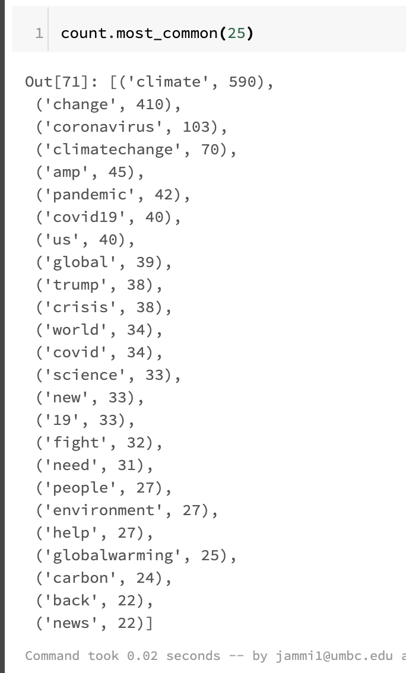

Dataset
Most common words count
Stored in CSV file
Created Test and Training Set
In process of validating training set against testing set

Slide 4
Objective Changes
Naïve Bayes classifier
Bag of Words
NLP

Slide 5
Model Construction
NLTK Polarity and Stop words
Logistic regression
Bag of Words
Notes:
Before we let our data to train we have to numerically represent the preprocessed data. The well-known techniques for vectorization of words in Natural Language Processing are: CountVectorization and Tf-IDF transformation. Let’s dive a bit into the theoretical background of those vectorization techniques.
CountVectorization generates a sparse matrix representing all the words in the document. A demonstration of Count Vectorization is given below:
What Tf-Idf transformer does is returns the product of Tf and Idf which is the Tf-Idf weight of the term.
Bag-of-Words is a method to represent text into numerical features

Slide 6
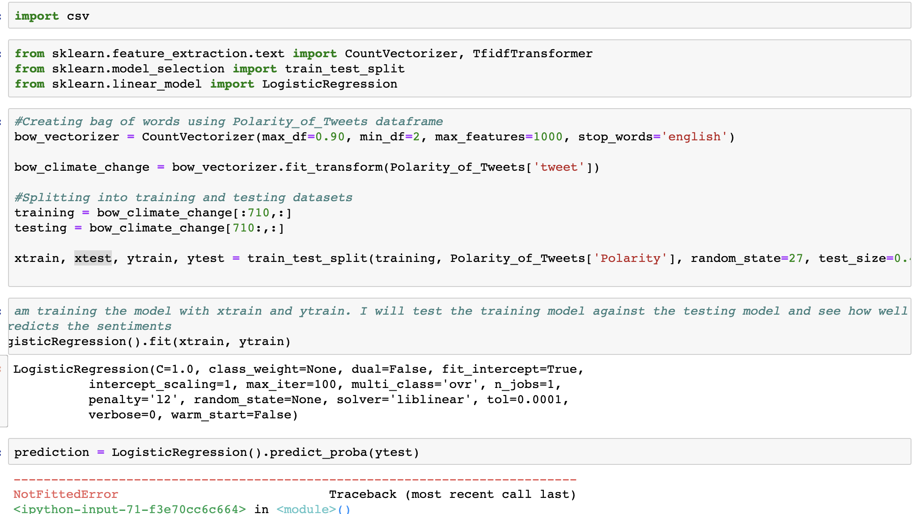

Slide 7
Results
Predictive Model has been fitted
In the process of predicting testing set
Will use TF-IDF
Naïve Bayes Classification

Slide 8
Deliverable 4 Plans
Finish the other two parts of my classifier
Validate my test set
Deploy on real time tweets

